Slide 1

Malignant
Comment
classifier
project
Presented By-
Shilpa Kewalaramani

Slide 2
Contents
Introduction
Objective
Data Insights
Checking Null value
Visualization of Data
Preprocessing of Data
Visualizing Loud Words
Rude comments
Abuse comments
Threat comments
Loathe Rating
Highly malignant
Converting of Text into Vectors
Methods used to Train-Test Data
Methods used to sample data
Key-Metrics used to choose best model
Final Decision of choosing model
Limitations and Future scope of project

Slide 3
Introduction
Online platforms when used by normal people can only be comfortably used by them only when they feel that they can express themselves freely and without any reluctance. If they come across any kind of a malignant or toxic type of a reply which can also be a threat or an insult or any kind of harassment which makes them uncomfortable, they might defer to use the social media platform in future. Thus, it becomes extremely essential for any organization or community to have an automated system which can efficiently identify and keep a track of all such comments and thus take any respective action for it, such as reporting or blocking the same to prevent any such kind of issues in the future.
This is a huge concern as in this world, there are 7.7 billion people, and, out of these 7.7 billion, more than 3.5 billion people use some or the other form of online social media. Which means that every one-in-three people uses social media platform. This problem thus can be eliminated as it falls under the category of Natural Language Processing. In this, we try to recognize the intention of the speaker by building a model that’s capable of detecting different types of toxicity like threats, obscenity, insults, and identity-based hate. Moreover, it is crucial to handle any such kind of nuisance, to make a more user-friendly experience, only after which people can actually enjoy in participating in discussions with regard to online conversation.

Slide 4
objective
The main objective behind making this project is to make a model that can read the comment and let us know whether the comment is malignant or not.

Slide 5
Data insights
CHECKING NULL VALUES
The very first thing was to check whether there are null values or not in the dataset. Null Values or missing values usually occurs whenever the entry is left empty, but there were no null values in the data. The null values were checked using dataframe.isnull().sum() function which checks and returns the sum of all null values of individual columns
and it was observed that :-
there were no null values in the train dataset
And
Intentionally null values were created to train the data

Slide 6
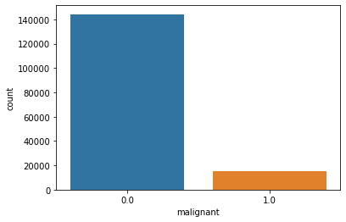
Visualization of data
The columns except id, and comment_text were visualized to know the counts unique values of each column
Like there are 15,249 malignant comments
And 1,44,277 comments are not malignant

Slide 7
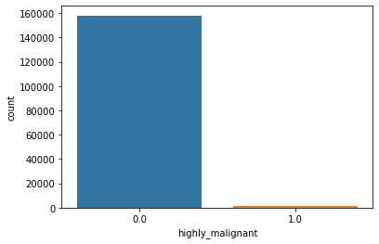
Visualization of data
The columns except id, and comment_text were visualized to know the counts unique values of each column
Like there are 15294 highly_malignant comments
And 1,44,277 comments are not malignant

Slide 8
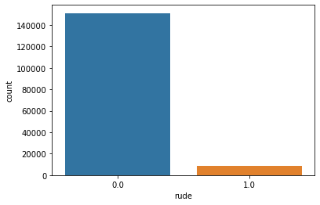
Visualization of data
The columns except id, and comment_text were visualized to know the counts unique values of each column
Like there are 8449 rude comments
And 1,51,122 comments are not malignant

Slide 9
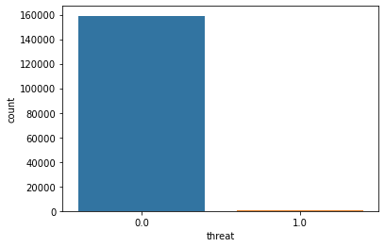
Visualization of data
The columns except id, and comment_text were visualized to know the counts unique values of each column
Like there are 478 Threatning comments
And 159093 comments are not malignant

Slide 10
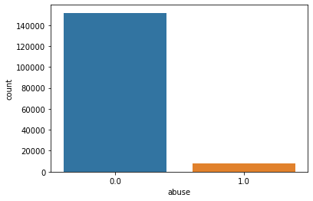
Visualization of data
The columns except id, and comment_text were visualized to know the counts unique values of each column
Like there are 7877 Abusing comments
And 151694 comments are not malignant

Slide 11
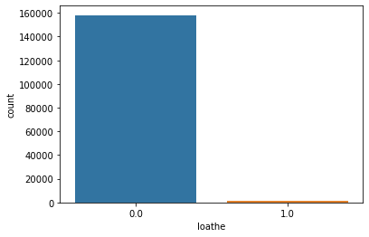
Visualization of data
The columns except id, and comment_text were visualized to know the counts unique values of each column
Like there are 1405 Loathe comments
And 158166 comments are not malignant

Slide 12
PREPROCESSING OF DATA
After checking the null values various steps were taken to preprocess the data like
Dropping of Unnecessary columns :- Intentionally no column were dropped using drop function but only comment_text and label was column was used for training
2) Original_Review_length : New column named as Original_Review_length was created to count the length original comment_text
3) Creating NEW COLUMN : new column named as “Label” was created to
Save the comment as malignant, highly_malignant, rude, loathe, threat, and abuse and not_malignant in a single column as target column

Slide 13
PREPROCESSING OF DATA
4) Cleaning Text:
i) Text was converted to lowercase
ii) Punctuations and Emojis were removed
iii) Special Characters were removed
iv) Stopwords ( except negative words ) were removed
5) Cleaned_Review_length : Cleaned_Review_length was created after cleaning the comment_text to measure the difference

Slide 14
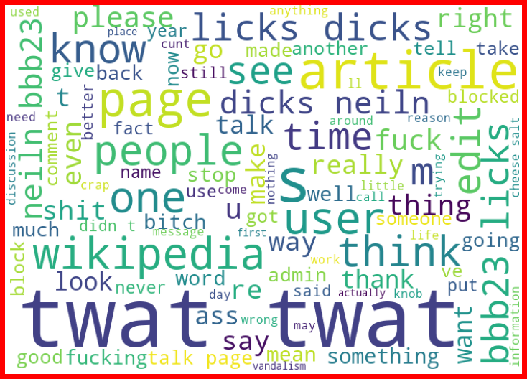
Visualizing loud words
All the Loud words that were
Present in comment_text having label of rude comments are displayed using
Wordcloud, in the adjacent picture
It is shown

Slide 15
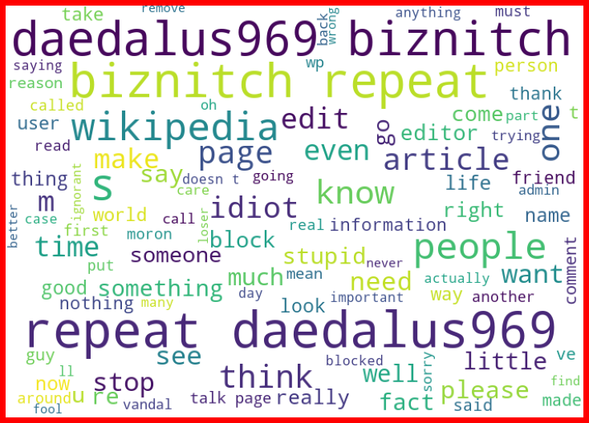
Visualizing loud words
All the Loud words that were
Present in comment_text having label of Abuse comments are displayed using
Wordcloud, in the adjacent picture
It is shown

Slide 16
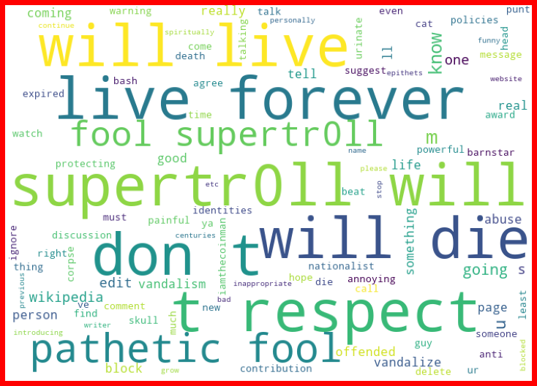
Visualizing loud words
All the Loud words that were
Present in comment_text having label of Threat comments are displayed using
Wordcloud, in the adjacent picture
It is shown

Slide 17
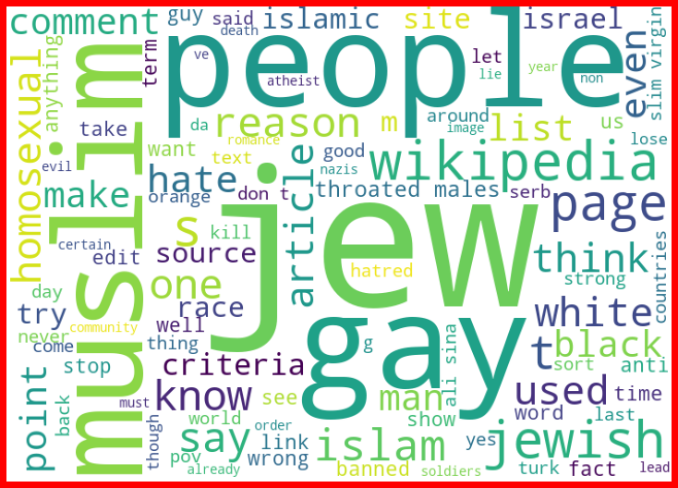
Visualizing loud words
All the Loud words that were
Present in comment_text having label of Loathe comments are displayed using
Wordcloud, in the adjacent picture
It is shown

Slide 18
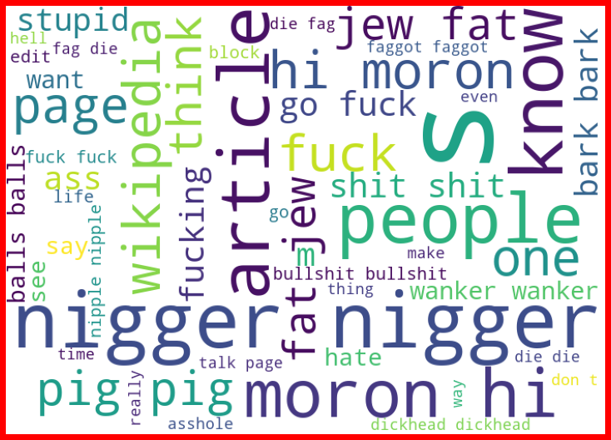
Visualizing loud words
All the Loud words that were
Present in comment_text having label of Highly__Malignant comments are displayed using
Wordcloud, in the adjacent picture
It is shown

Slide 19
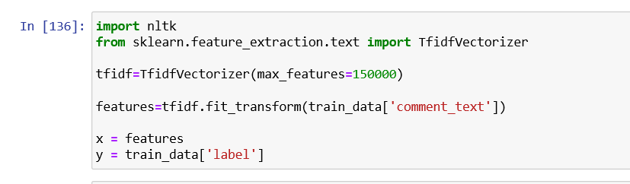
Converting Text into Vector
The text in the comment_text column was converted into text through
TfidfVectorizer
And the features and target were assigned to X and Y respectively

Slide 20
Models used to Train-test data
1)MultinomialNB
2)Logistic Regression
3)RandomForestClassifier
4)DecisionTreeClassifier
5)SupportVectorClassifier

Slide 21
Methods used to BALANCE data
RandomOverSampler

Slide 22
Key Metrics used to choose model
Accuracy
Precision
Recall
F1-score
Log loss

Slide 23
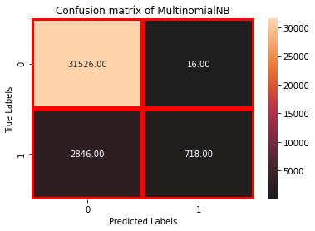
Performance of each model
1)Multinomial nb
MultinomialNB performed good it got
Accuracy – 91.84
Log Loss - 0.31
F1-score - 0.96 of class 0 and 0.33 of class 1
Precision - 0.92 of class 0 and 0.98 of class 1
Recall - 1.00 of class 0 and 0.20 of class 1

Slide 24
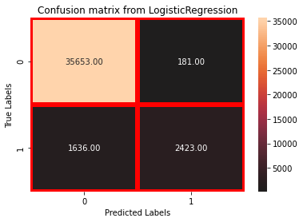
Performance of each model
2) LOGISTIC REGRESSION
Logistic Regression performed good it got
Accuracy – 95.44
Log Loss - 0.12
F1-score - 0.98 of class 0 and 0.73 of class 1
Precision - 0.96 of class 0 and 0.93 of class 1
Recall - 0.99 of class 0 and 0.60 of class 1

Slide 25
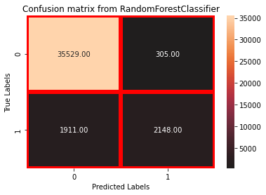
Performance of each model
3) rANDOM FOREST CLASSIFIER
RandomForestClassifier performed good it got
Accuracy – 94.44
Log Loss - 0.14
F1-score - 0.97 of class 0 and 0.66 of class 1
Precision - 0.95 of class 0 and 0.88 of class 1
Recall - 0.99 of class 0 and 0.53 of class 1

Slide 26
Performance of each model
4) Decision Tree CLASSIFIER
DecisionTreeClassifier performed good it got
Accuracy – 93.44
Log Loss - 1.96
F1-score - 0.96 of class 0 and 0.69 of class 1
Precision - 0.97 of class 0 and 0.67 of class 1
Recall - 0.96 of class 0 and 0.71 of class 1

Slide 27

Performance of each model
4) Decision Tree CLASSIFIER
DecisionTreeClassifier performed good it got
Accuracy – 95.77
Log Loss - ---
F1-score - 0.98 of class 0 and 0.75 of class 1
Precision - 0.96 of class 0 and 0.94 of class 1
Recall - 1.00 of class 0 and 0.62 of class 1

Slide 28
Final decision of choosing model
ACCURACY- Logistic Regression and SupportVectorClassifier are having good accuracy of 95 followed by RandomForestClassifier as 94, DecisionTreeClassifier as 93 and MultinomialNB as 91. so for here 1 vote for LogisticRegression
* LOG-LOSS - (As the model with perfect skill has a log loss score of 0.0. ) Here SupportVectorClassifier is showing no Log-loss because of probability factor=False and DecisionTreeClassifier has highest log-loss of 2.2 then MultinomialNB has log-loss of 0.33 and the least log loss is of RandomForestClassifier i.e., 0.15 and least than it is of Logistic Regression i.e., 0.12, So here 1 vote for Logiostic Regression and RandomForestClassifier
* PRECISION - Here the first number is precision of 0 and second of 1 , so all the models has got good precisions like at first SupportVector, MultinomialNB, then LogisticRegression , then RandomForest, and at last DecisionTree . So here 1 vote for SupportVector, MultinomialNB, LogisicRegression and RandomForestClassifier

Slide 29
Final decision of choosing model and samplers
* F1-SCORE - Here also the first number is f1-score of 0 and second of 1, as it can be observed that f1-score of 0 of all models is pretty good, so using the f1-score to select best model like Support Vector has got good f1-score of 1 as 75, logistic Regression has got 73, followed by DecisionTree as 69, RandomForest as 65 and MultinomialNB as 29 so 1 vote for all models Logistic, Random, SupportVector, DecisionTree and not for Multinomial NB
Counting Final Votes
* accuracy - LogisticRegression
* log_loss - LogisticRegression , RandomForestClassifier
* precision - SupportVector, MultinomialNB, LogisicRegression and RandomForestClassifier
* f1-score - LogisicRegression, SupportVector, RandomForestClassifierand DecisionTree

Slide 30
Limitations and Future scope of project
Limitations:
Well I did not found any limitation, but to improve the result we need more malignant comments that will help the model to learn more better .
Future Scope :
This model can be used by the all the websites which deal in the posting comments like twitter. It can control such comments to be posted by applying filter on its server end. Or It can warn the person that such comments may put them in some problems

Slide 31
Thank you

